Slide 1
The Gaming Industry
A study about the leading players and performance of popular games in different markets based on sales data
Suvaansh Kumar n01351862
Navdeep Singh n01352563

Slide 2
Outline
We will be using the DPLYR library in RStudio to make some conclusions about data that we have. The project will help us give insights in the industry and see how the projects that have been undertaken in the industry have fared.
We will try to query the different games and different platforms that we have in the data set to make our conclusions which will help us judge how the industry is doing.

Slide 3
Background
So the data that we are using here is a 11 column csv data file with over 16000 rows, the data was freely available from kaggle.com . The data gives us a lot of insight in the gaming industry which generated sales of $135 Billion in 2018 alone. With the data we can chart how the industry has been growing year on year from the past years, how it has been performing in the years till now and how the performance of popular games in major markets has been.

Slide 4
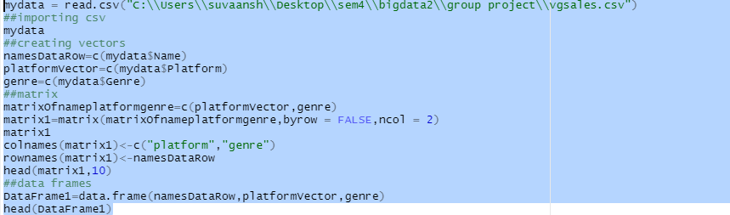
Utilizing vector matrix and Data frame

Slide 5
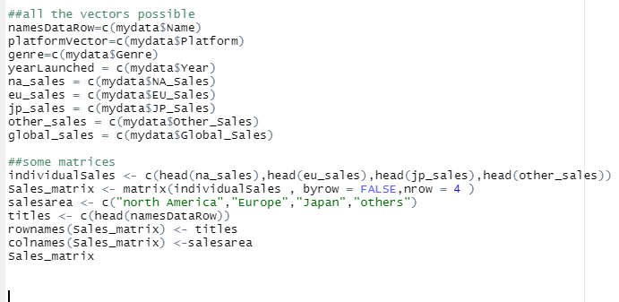

Slide 6
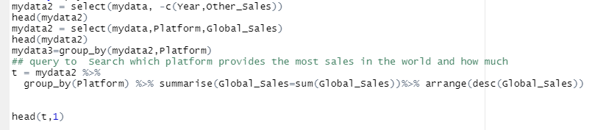

query to Search which platform provides the most sales in the world and how much?

Slide 7
Explanation
In this query we are using mydata2 which is selecting platform and global sales columns for analysis
And then we are using group by function to group by platform and then through pipe we are summarising it to get th sum of sales .
And then we are arranging in descending order .

Slide 8
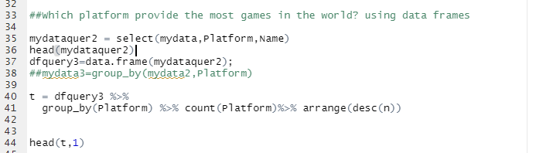

Which platform provide the most games in the world? using data frames

Slide 9
explanation
Using select function we are selectin platform and name and then we are creating dataframes on that basis
After this using pipe we are doing group by , count and arranging in descending order .

Slide 10
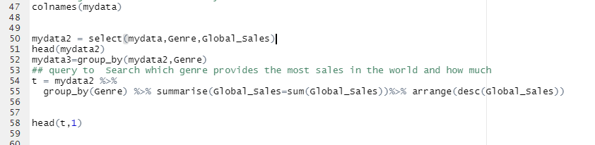

Which genre earn the most money in the world?
aaadas

Slide 11
The REsult says that the action Genre is the one giving most of the sales

Slide 12
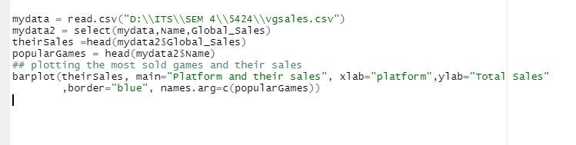
How have the most popular games performed?

Slide 13
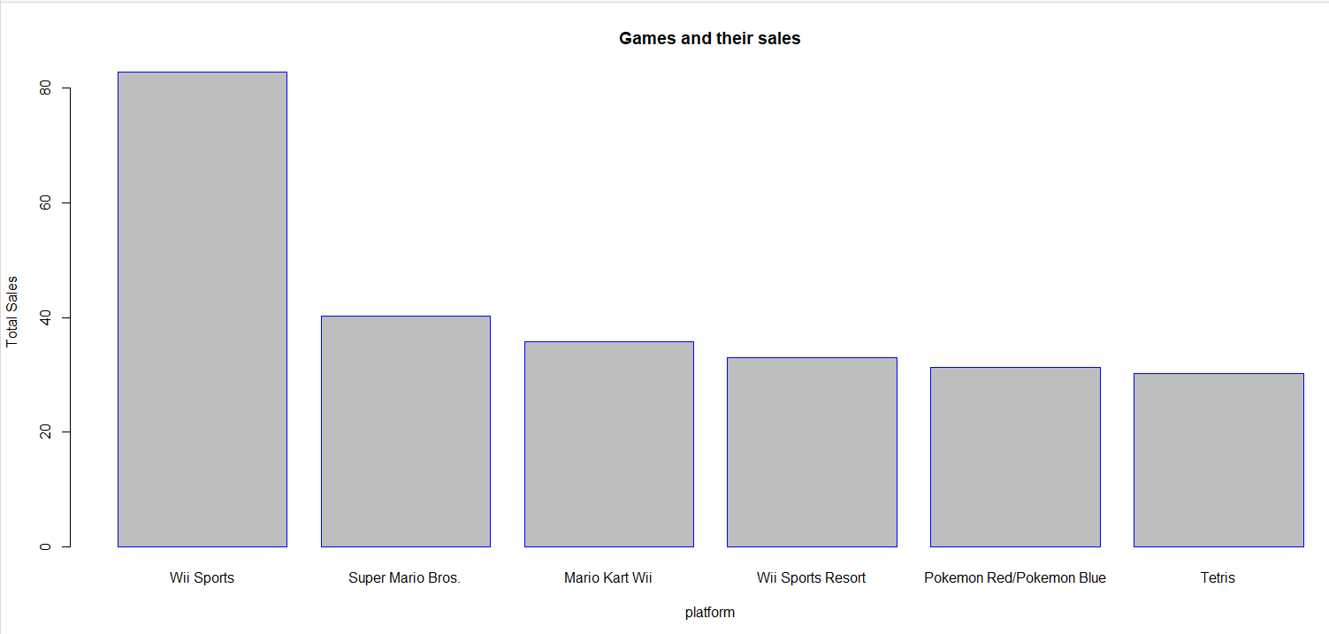

Slide 14
Conclusion
Basic games have earned more money overall than the really expensive and more intensive games.

Slide 15

The bargraph of the total sale of games of each platform

Slide 16
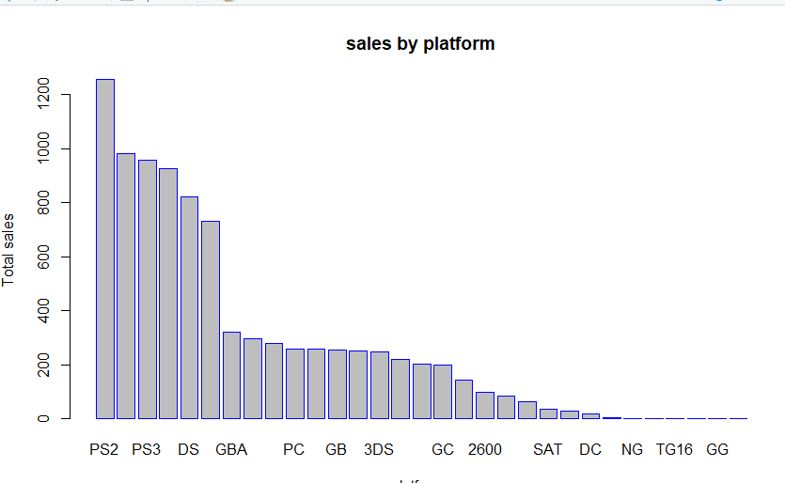

Slide 17
Deduction
PS2 was around the time that games really started picking up and has resulted in an overall boom in the industry plus has also resulted in being the most successful platform till now.

Slide 18
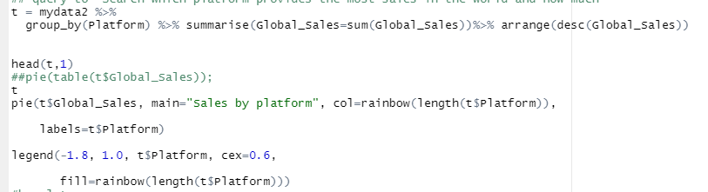
A pie-chart of the total sales as compared to sales of each platform

Slide 19
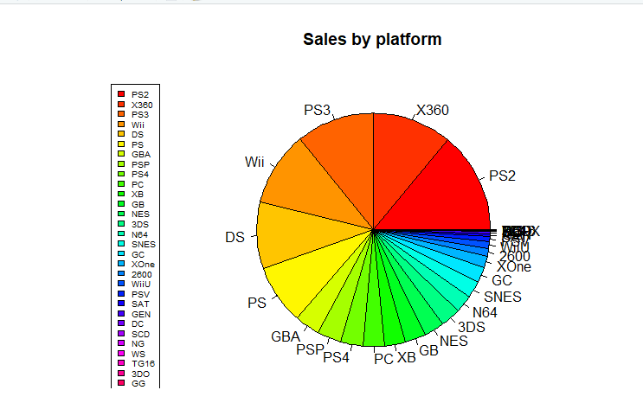

Slide 20
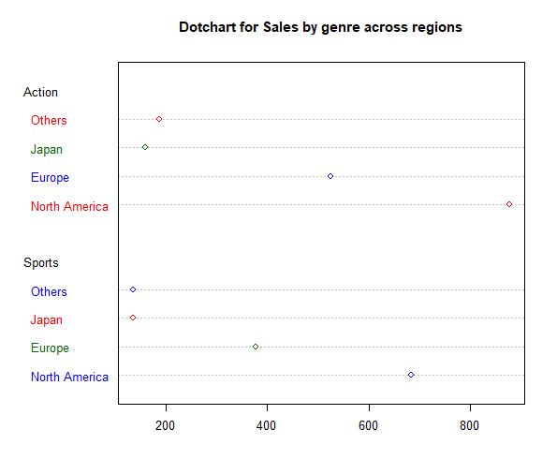

Slide 21
Explanation
This pie chart shows graphically how the different platforms have performed in the market and what their share has been in overall market.

Slide 22
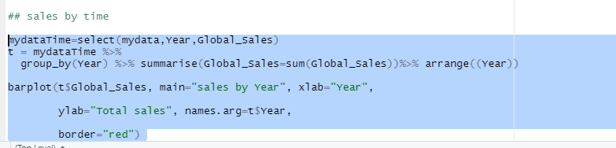
Sale of games over the years

Slide 23
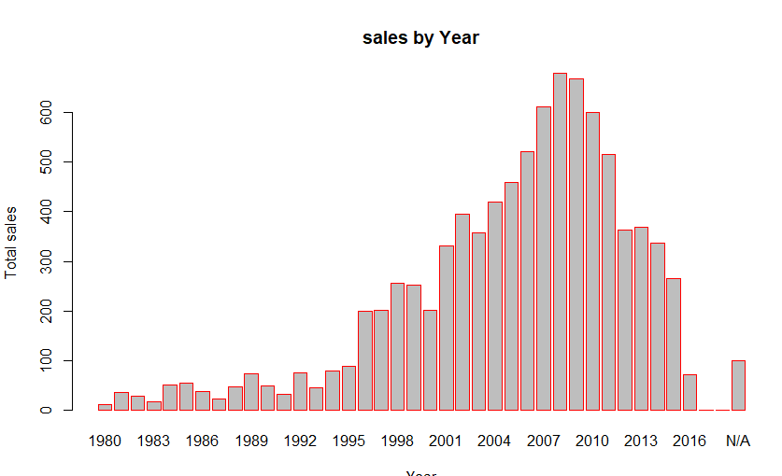

Slide 24
Explanation
Here we can see how from the start of the new millennium, the sale of games have been picking up and increasing year on year. This proves that gaming industry is booming and would be a good place to invest in.

Slide 25
Conclusion
Through our queries we have been able to gather some insights in the gaming industry, although it looks like the sales were picking up and have dropped now in number, but that is only true because the games have become more expensive and developers just tend to spend more time in developing them and rolling them out.
The revenue generated in 2018 was $135 Billion and that is more than both the music($21 Billion) and film industry($110 Billion) combined! So this is definitely an industry that deserves more credit

Slide 26




Slide 27
References:
https://www.kaggle.com/gregorut/videogamesales?select=vgsales.csv
https://rstudio.com/wp-content/uploads/2015/02/data-wrangling-cheatsheet.pdf
https://genomicsclass.github.io/book/pages/dplyr_tutorial.html

